Slide 1

Developers: Blair Gentry, Geoffrey Blech, Linh Tran, Travis Cox
Notes:
Geoff

Slide 2

What is PubHub?
Notes:
Geoff

Slide 3
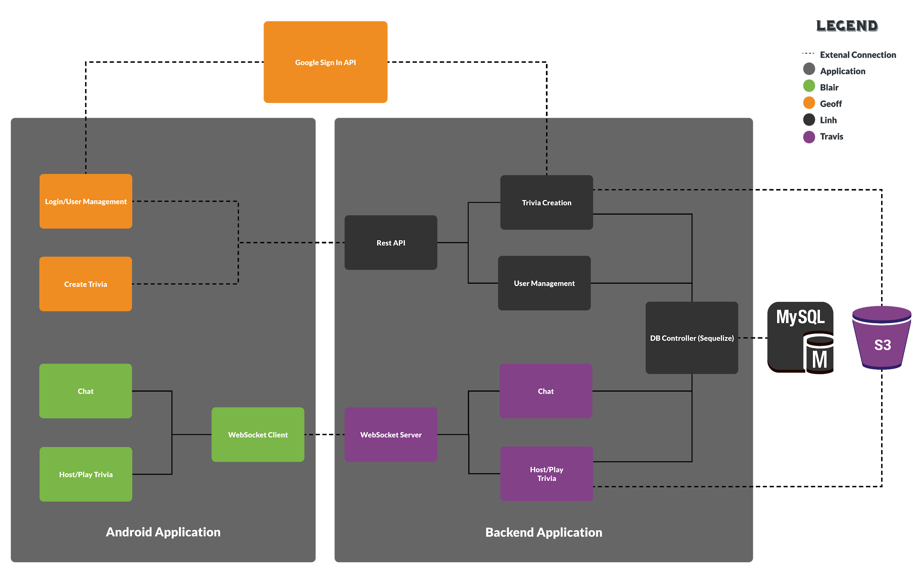
System Architecture
Notes:
Travis

Slide 4
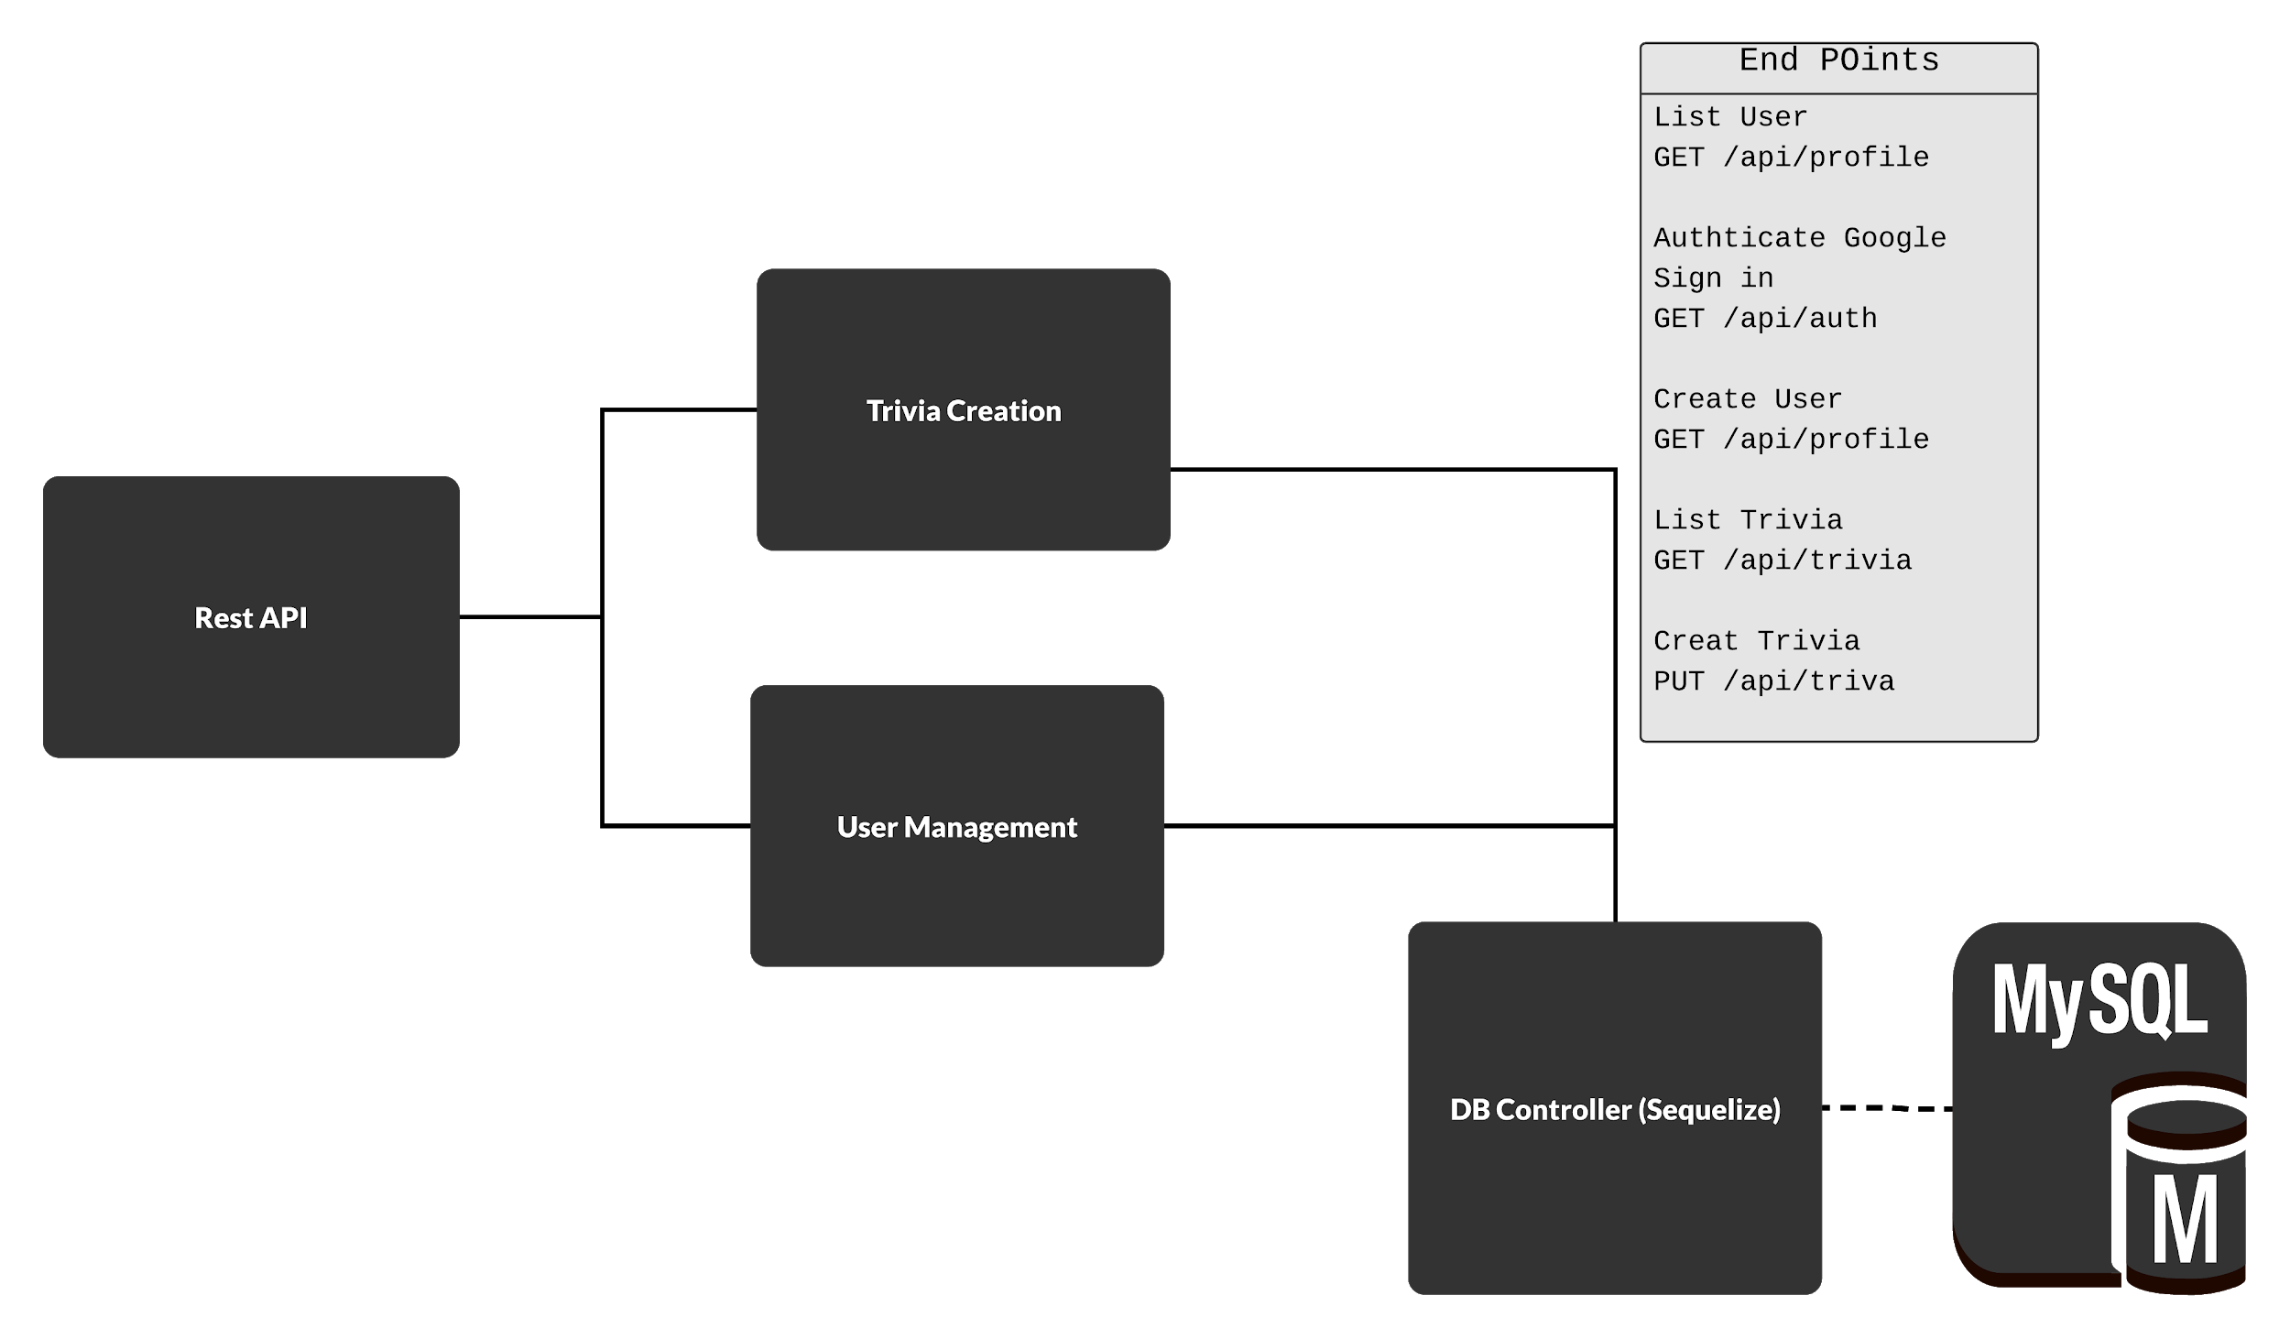
REST API
Rest API
Set up the end points
Handle:
Sign-in
User management
Trivia Creation
Sequelize
Database Controller
Scalable
Notes:
Linh:

Slide 5
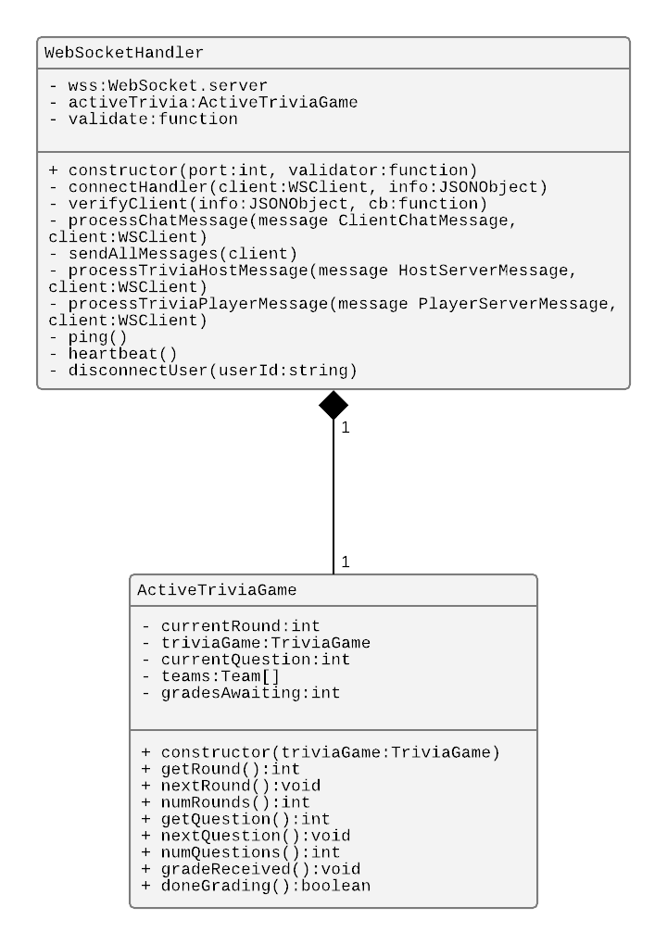
WebSockets Server
Handles real time communication between the server and client.
Chat
Playing Trivia
Manages the active trivia game.
Manages the game’s status
Creates teams
Controls progress through the trivia game
Notes:
Travis

Slide 6
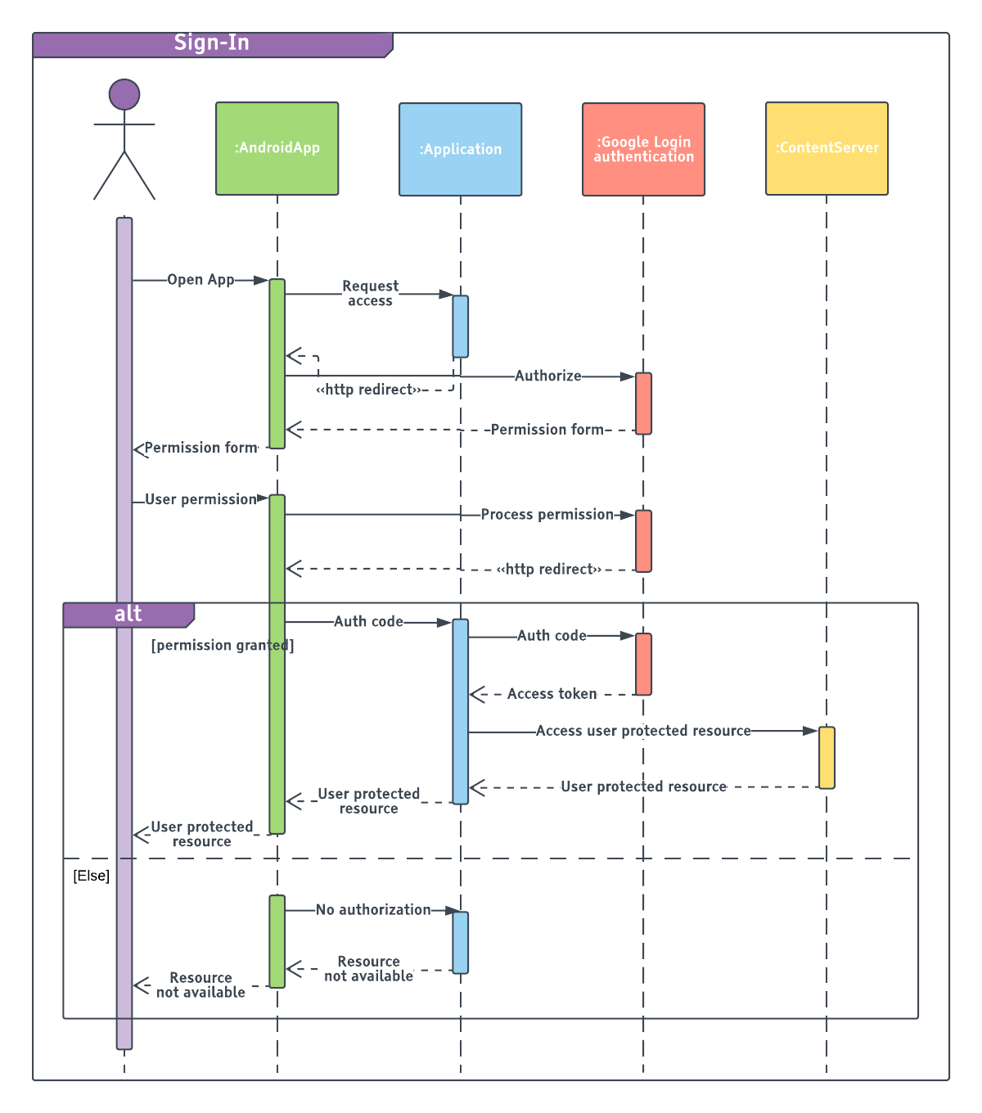
Sign In
Google Sign-In
Simplify the sign-in process
User Data not stored in database
Future integration
Facebook Sign-in
GitHub sign-in
Notes:
Geoff/Linh
Google sign token, sent to the rest API

Slide 7
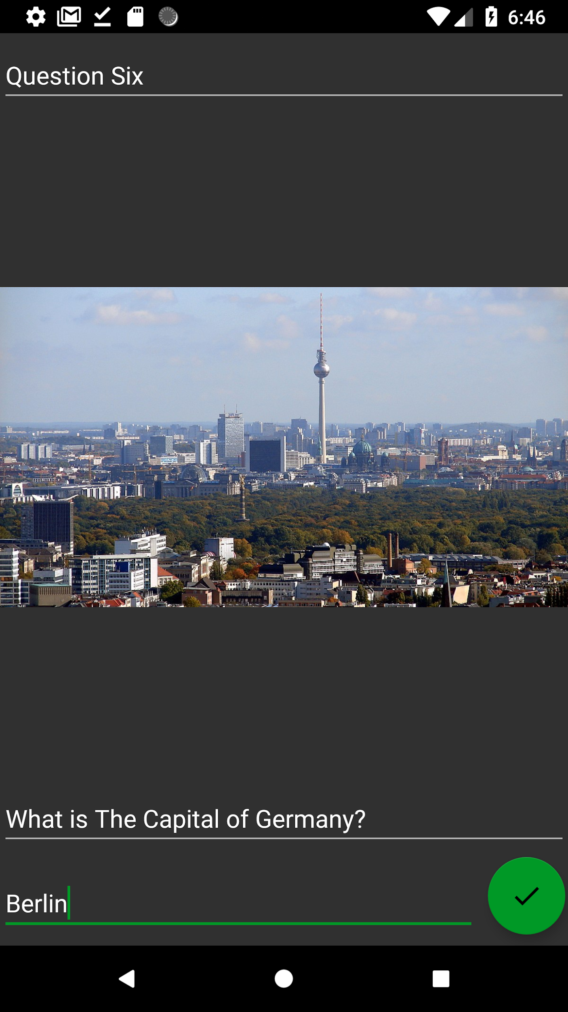
Trivia Creation
Host accesses this feature where they enter all the information needed for a game a of trivia.
Notes:
Geoff

Slide 8
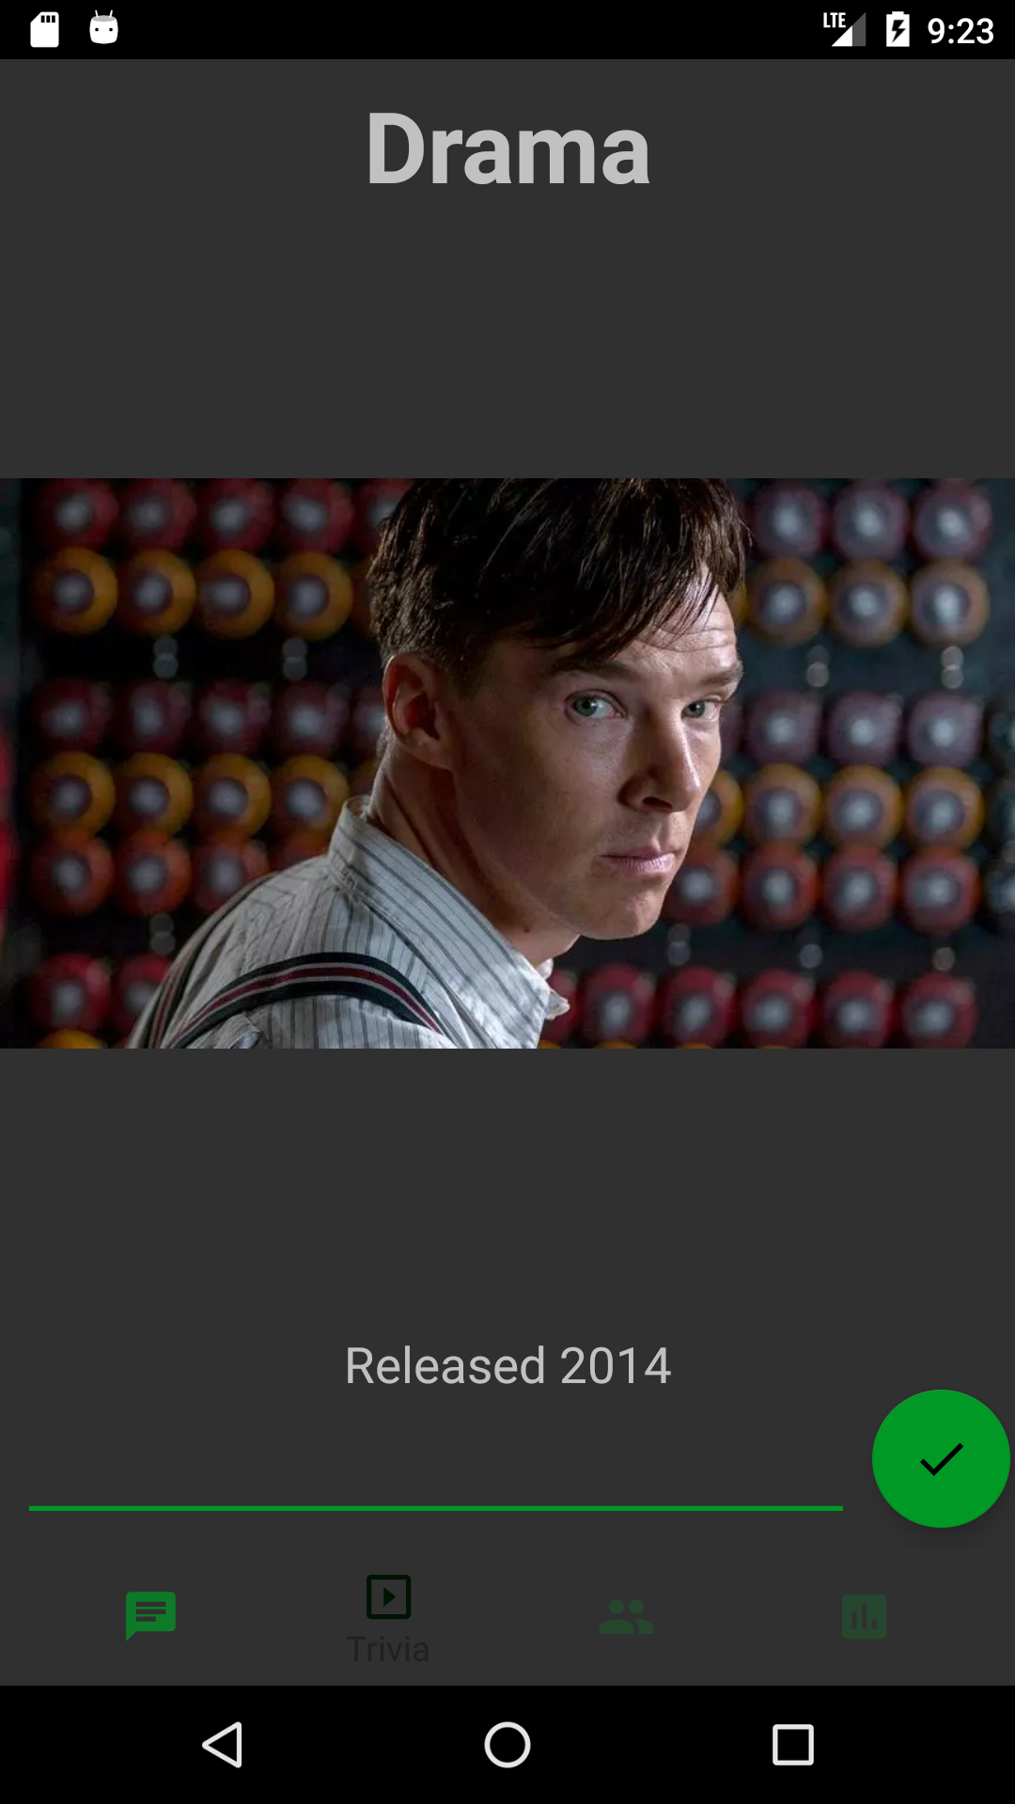
Trivia Playing
Live slide updates from Host
Each team member can submit answers
Team leader locks in team answer
Game Setup
Game
Round(s)
Question(s)
Notes:
Blair

Slide 9
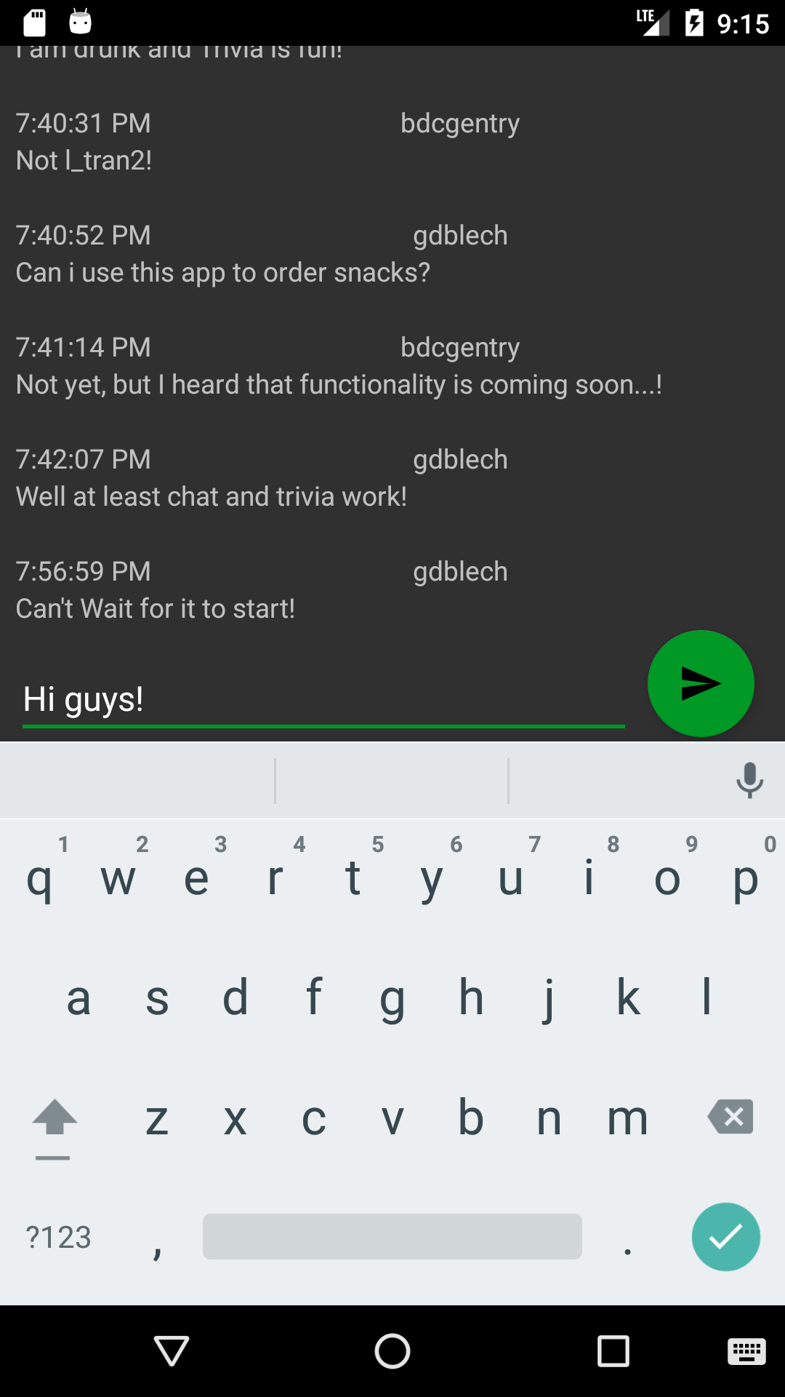
Chat
Connect with others in the bar as soon as you log on
Real-time connection using WebSockets
Simple switching between trivia playing and chatting
Notes:
Blair

Slide 10
Demo

